Slide 1
Database Management Systems
Semester III

Slide 2
Unit 1
Introduction to Databases and Transactions
What is database system
Purpose of database system
View of data
Relational databases
Database architecture
Transaction management

Slide 3
What is Data?
Data can be facts related to any object in consideration.
Eg: Your Name, Age, Height, Weight etc. are some data related to you.
A picture, pdf, file can also be considered data.

Slide 4
What is database system?
A database is a systematic collection of data.
It is basically just a computerized record -keeping system.
Different types of database:
Traditional database
Multimedia database
Geographic Information System
Distributed database

Slide 5
DBMS
A database management system(DBMS) is a collection of interrelated data and a set of programs to access those data.
Examples:
Online Telephone Directory
Banking
Universities
Airlines

Slide 6
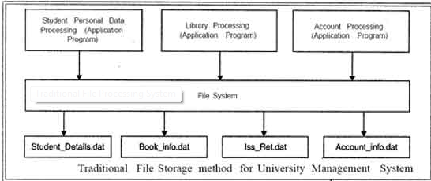
Purpose of Database system

Slide 7
Drawbacks of File processing systems:
Data redundancy and inconsistency.
Difficulty in accessing data.
Data isolation.
Integrity problems.
Atomicity problems.
Concurrent access anomalies.
Security problems.

Slide 8
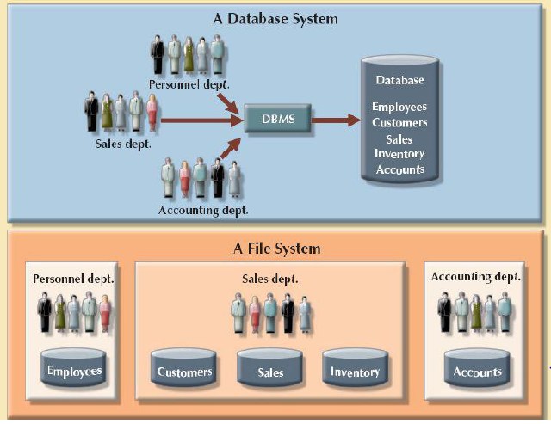
Database vs. File system

Slide 9
View of data
Data abstraction
Physical level- How the data are actually stored.
Logical level- What data are stored and what relationship exist among those data.
View level- Describes only part of the entire database.

Slide 10
ER diagram
Entity
An entity can be a real-world object, either animate or inanimate, that can be easily identifiable.
For example, in a school database, students, teachers, classes, and courses offered can be considered as entities.
All these entities have some attributes or properties that give them their identity.

Slide 11

Entity Set
An entity set is a collection of similar types of entities.
For example, a Students set may contain all the students of a school; likewise a Teachers set may contain all the teachers of a school from all faculties.
Represented using rectangle.

Slide 12
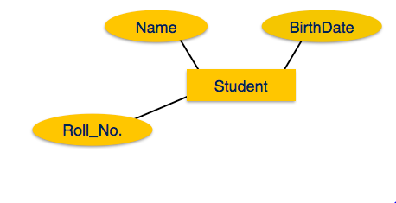
Attributes
Attributes are the properties of entities.
Attributes are represented by means of ellipses. Every ellipse represents one attribute and is directly connected to its entity (rectangle).

Slide 13
Types of attributes:-
Simple attributes:- They are atomic values, which cannot be divided further. For example, a student's phone number is an atomic value of 10 digits.
2. Composite attribute:- They are made of more than one simple attribute. For example, a student's complete name may have first_name and last_name.

Slide 14
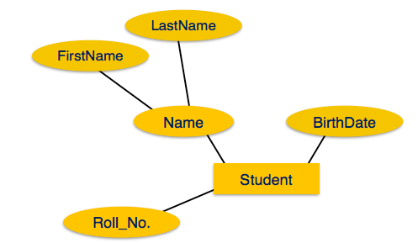

Slide 15
3. Derived attribute
Derived attributes are the attributes whose values are derived from other attributes present in the database. Denoted by dotted ellipse
For example, age can be derived from data_of_birth.
4. Single-valued attribute
Single-value attributes contain single value. For example − EmployeeID

Slide 16
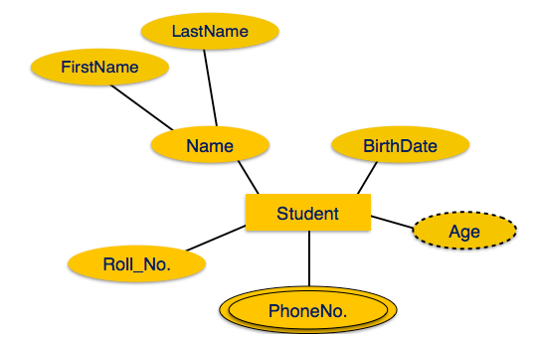
5. Multivalued attribute
Multi-value attributes may contain more than one values. For example, a person can have more than one phone number, email_address, etc.

Slide 17
Relationship & Relationship set
The association among entities is called a relationship.
For example, an employee works_at a department, a student enrolls in a course. Here, Works_at and Enrolls are called relationships.

Slide 18
Relationship set
A set of relationships of similar type is called a relationship set.
Like entities, a relationship too can have attributes. These attributes are called descriptive attributes.
Representation:-
Relationships are represented by diamond-shaped box. Name of the relationship is written inside the diamond-box. All the entities (rectangles) participating in a relationship, are connected to it by a line.

Slide 19
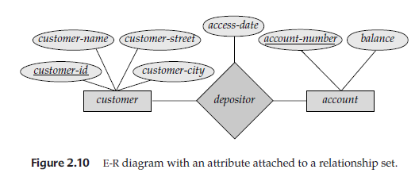

Slide 20
Cardinalities
Cardinality defines the number of entities in one entity set, which can be associated with the number of entities of other set via relationship set.
One to One relationship
One entity from entity set A can be associated with at most one entity of entity set B and vice versa.

Slide 21
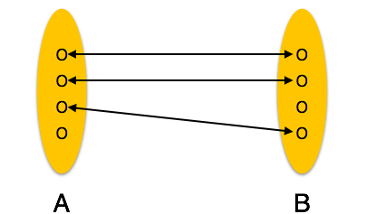
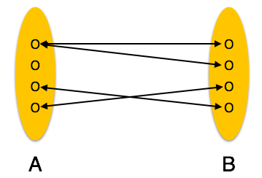
One to one
One to many

Slide 22
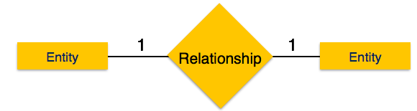
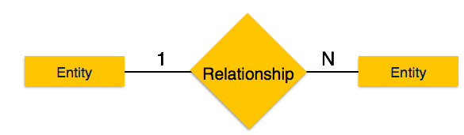

Slide 23
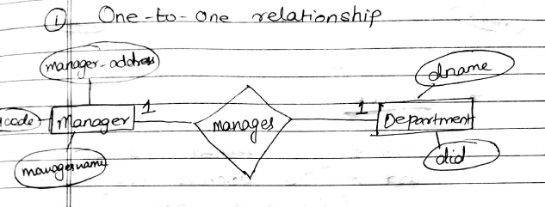

Slide 24
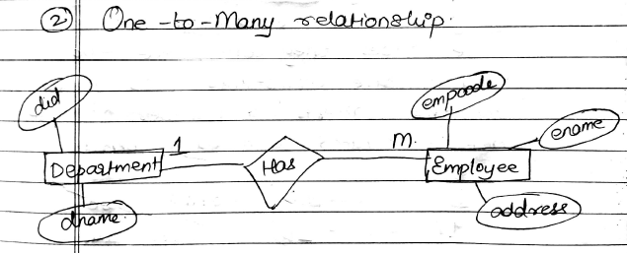

Slide 25
2. One to many relationship
- One entity from entity set A can be associated with more than one entities of entity set B however an entity from entity set B, can be associated with at most one entity.
3. Many to one relationship
- More than one entities from entity set A can be associated with at most one entity of entity set B, however an entity from entity set B can be associated with more than one entity from entity set A.

Slide 26
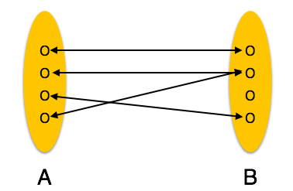
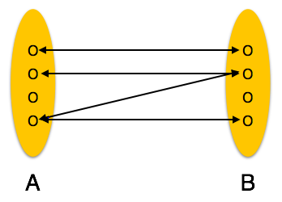
Many to one
Many to many

Slide 27
4. Many to many relationship
One entity from A can be associated with more than one entity from B and vice versa.

Slide 28
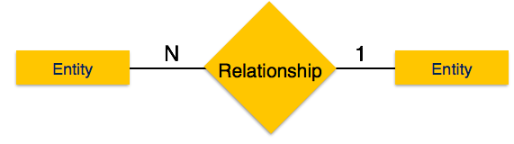
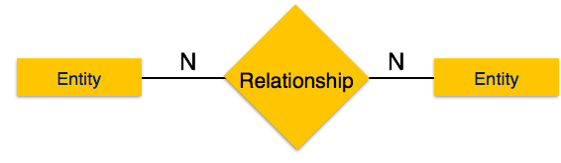

Slide 29
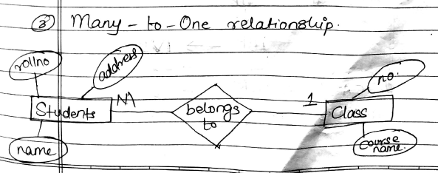

Slide 30
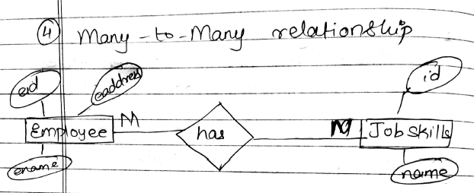

Slide 31
Participation Constraint
Types of participation:-
Total participation:- Each entity is involved in the relationship. Total participation is represented by double lines.
Partial participation:-Not all entities are involved in the relationship. Partial participation is represented by single lines.

Slide 32
1. Participation of loan in borrower is total.
i.e. every loan must have a customer associated to it via borrower.
2. Participation of customer in borrower is partial. i.e. an individual can be a bank customer whether or not he/she has a loan with the bank.
Hence, it is possible that only some of the customer entities are related to the loan entity set through the borrower relationship

Slide 33
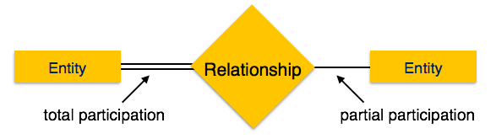

Slide 34
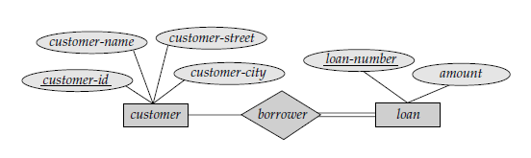

Slide 35
Key attribute
Key is an attribute or collection of attributes that uniquely identifies an entity among entity set.
For example, the roll_number of a student makes him/her identifiable among students.
keyattribute

Slide 36
Primary key
A primary key is a field in a table which uniquely identifies each row/record in a database table.
Primary keys must contain unique values.
A primary key column cannot have NULL values.
In ER diagram primary key is denoted by underline.
Rollno

Slide 37
Strong and Weak Entity Sets
An entity set that does not have a primary key is referred to as a weak entity set.
An entity set that has a primary key is termed a strong entity set.
The existence of a weak entity set depends on the existence of a strong entity set.

Slide 38
We depict a weak entity set by double rectangles.
Weak entity do not have the primary key instead it has a partial key that uniquely discriminates the weak entities.
Weak entities are dependent where as strong entities are independent.

Slide 39
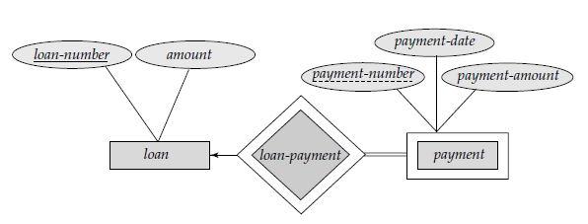

Slide 40
consider the entity set payment, which has the three attributes:
payment-number, payment-date, and payment-amount.
Payment numbers are typically sequential numbers, starting from 1, generated separately for each loan.
Thus, although each payment entity is distinct, payments for different loans may share the same payment number.
Thus, this entity set does not have a primary key; it is a weak entity set.

Slide 41
For a weak entity set to be meaningful, it must be associated with another entity set, called the identifying or owner entity set.
that is, the weak entity set is said to be existence dependent on the identifying entity set.
The identifying entity set is said to own the weak entity set.

Slide 42
The primary key of a weak entity set is formed by the primary key of the identifying entity set, plus the weak entity set’s partial key.
In the case of the entity set payment, its primary key is {loan-number, payment-number},
where loan-number is
the primary key of the identifying entity set, namely loan, and
payment-number distinguishes
payment entities within the same loan.

Slide 43
The use of double lines indicate total participation—the
participation of the (weak) entity set payment in the relationship loan-payment is total,
meaning that every payment must be related via loan-payment to some loan.

Slide 44
Other examples
Room and Hotel
The existence of rooms is entirely depended on the existence of a hotel. So room can be seen as the weak entity of the hotel.
Bank and Account
Bank account of a particular bank has no existence if the bank doesn't exist anymore.
Account is a weak entity.

Slide 45
Extended E-R Features
Generalization
Generalization is a bottom-up approach in which lower level entities having similar characteristics combine to form a higher level entity.

Slide 46
2. Specialization
Specialization is opposite to Generalization.
It is a top-down approach in which one higher level entity can be broken down into several lower level entity.
In specialization, some higher level entities may not have lower-level entity sets at all.

Slide 47
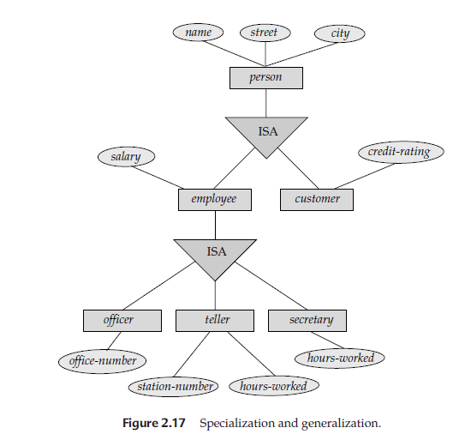

Slide 48
3. Attribute Inheritance
Inheritance is an important feature of Generalization and Specialization.
It allows lower-level entities to inherit the attributes of higher-level entities.
For example, the attributes of a Person class such as name, age, and gender can be inherited by lower-level entities such as Student or Teacher.

Slide 49
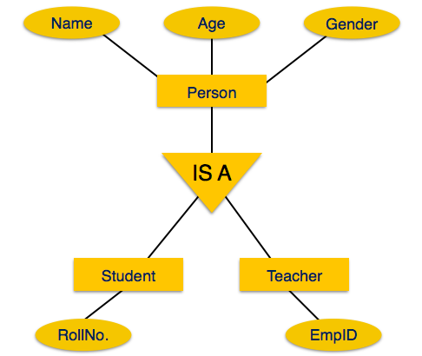

Slide 50
ERD Issues
1. Use of entity sets vs attributes
Consider the entity set employee with attributes employee-name and telephone-number.
It can easily be argued that a telephone is an entity in its own right with attributes telephone-number and department (the office where the telephone is located).

Slide 51
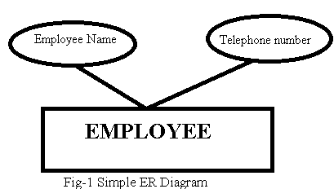
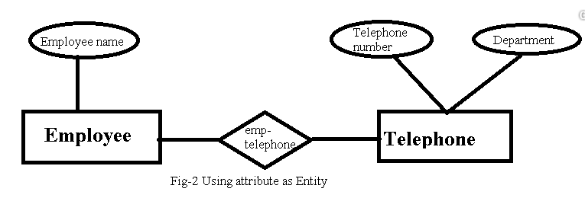

Slide 52
If we take this point of view, we must redefine the employee entity set as:
> The employee entity set with attribute employee-name
> The telephone entity set with attributes telephone-number and location
> The relationship set emp-telephone, which denotes the association between employees and the telephones that they have

Slide 53
Treating a telephone as an attribute telephone-number implies that employees have precisely one telephone number each.
Treating a telephone as an entity telephone permits employees to have several telephone numbers associated with them.
However, we could instead easily define telephone-number as a multivalued attribute to allow multiple telephones per employee.

Slide 54
2. Use of entity set vs. relationship set.
Earlier we assumed that a bank loan is modeled as an entity.
An alternative is to model a loan not as an entity, but rather as a relationship between customers and branches, with loan-number and amount as descriptive attributes.
Each loan is represented by a relationship between a customer and a branch.

Slide 55
If every loan is held by exactly one customer and is associated with exactly one branch, we may find satisfactory the design where a loan is represented as a relationship.
However, with this design, we cannot represent conveniently a situation in which several customers hold a loan jointly.
To handle such a situation, we must define a separate relationship for each holder of the joint loan.

Slide 56
Then, we must replicate the values for the descriptive attributes loan-number and amount in each such relationship.
Each such relationship will have the same value for the descriptive attributes loan-number and amount.
Two problems arise as a result of the replication: (1) the data are stored multiple times, wasting storage space
(2) updates potentially leave the data in an inconsistent state, where the values differ in two relationships for attributes that are supposed to have the same value.

Slide 57
3. Binary vs. n-ary relationship set
Relationships in databases are often binary.
Some relationships that appear to be non-binary could actually be better represented by several binary relationships.
For instance, one could create a ternary relationship parent, relating a child to his/her mother and father.
However, such a relationship could also be represented by two binary relationships, mother and father, relating a child to his/her mother and father separately.

Slide 58
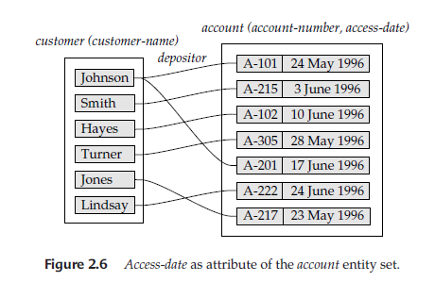
4. Placement of relationship attribute
For one to one and one to many relationship

Slide 59
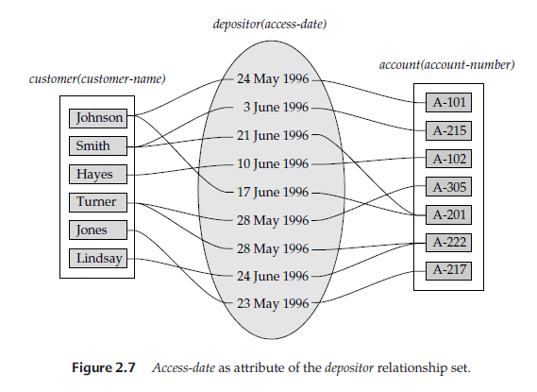
For many to many relationship

Slide 60
The cardinality ratio of a relationship can affect the placement of relationship attributes.
Thus, attributes of one-to-one or one-to-many relationship sets can be associated with one of the participating entity sets, rather than with the relationship set.
For instance, let us specify that depositor is a one-to-many relationship set such that one customer may have several accounts, but each account is held by only one customer.
In this case, the attribute access_date, which specifies when the customer last accessed that account, could be associated with the account entity set,

Slide 61
In another case, depositor is a many-to-many relationship set expressing that a customer may have one or more accounts, and that an account can be held by one or more customers.
If we are to express the date on which a specific customer last accessed a specific account, access-date must be an attribute of the depositor relationship set, rather than either one of the participating entities.
If access-date were an attribute of account, for instance, we could not determine which customer made the most recent access to a joint account.

Slide 62
Example on ER
A football club has a name and a ground and is made up of players. A player can play for only one club and a manager, represented by his name manages a club. A footballer has a registration number , name and age. A club manager also buys players. Each club plays against each other club in the league and matches have a date, venue and score.

Slide 63
Examples on ER
Suppose you are given the following requirements for a simple database for the National Hockey League (NHL):
the NHL has many teams,
each team has a name, a city, a coach, a captain, and a set of players,
each player belongs to only one team,
each player has a name, a position (such as left wing or goalie), a skill level, and a set of injury records,
a team captain is also a player,
a game is played between two teams (referred to as host_team and guest_team) and has a date (such as May 11th, 1999) and a score (such as 4 to 2).

Slide 64
Example
Consider a database used to record the marks that students get in different exams of different course offerings.
Construct an E-R diagram that models exams as entities, and uses a ternary relationship, for the above database.

Slide 65
Codd’s Rules
Dr Edgar F. Codd, after his extensive research on the Relational Model of database systems, came up with twelve rules of his own, which according to him, a database must obey in order to be regarded as a true relational database.
Rule zero:-
This rule states that for a system to qualify as an RDBMS, it must be able to manage database entirely through the relational capabilities.

Slide 66
Rule 1: Information Rule
The data stored in a database, may it be user data or metadata, must be a value of some table cell. Everything in a database must be stored in a table format.
Rule 2: Guaranteed Access Rule
Every single data element (value) is guaranteed to be accessible logically with a combination of table-name, primary-key (row value), and attribute-name (column value).

Slide 67
Rule 3: Systematic Treatment of NULL Values
Null has several meanings, it can mean missing data, not applicable or no value. It should be handled consistently. Primary key must not be null.
Rule 4: Active Online Catalog
The structure description of the entire database must be stored in an online catalog, known as data dictionary, which can be accessed by authorized users. Users can use the same query language to access the catalog which they use to access the database itself.

Slide 68
Rule 5: Comprehensive Data Sub-Language Rule
A database can only be accessed using a language having linear syntax that supports data definition, data manipulation, and transaction management operations. This language can be used directly or by means of some application. If the database allows access to data without any help of this language, then it is considered as a violation.

Slide 69
Rule 6: View Updating Rule
All the views of a database, which can theoretically be updated, must also be updatable by the system.
Rule 7: High-Level Insert, Update, and Delete Rule
A database must support high-level insertion, updation, and deletion. This must not be limited to a single row, that is, it must also support union, intersection and minus operations to yield sets of data records.

Slide 70
Rule 8: Physical Data Independence
The data stored in a database must be independent of the applications that access the database. Any change in the physical structure of a database must not have any impact on how the data is being accessed by external applications.
If say, some file supporting table were renamed or moved from one disk to another, it should not effect the application.

Slide 71
Rule 9 : Logical Data Independence
If there is change in the logical structure(table structures) of the database the user view of data should not change. Say, if a table is split into two tables, a new view should give result as the join of the two tables. This rule is most difficult to satisfy.
Rule 10: Integrity Independence
A database must be independent of the application that uses it. All its integrity constraints can be independently modified without the need of any change in the application. This rule makes a database independent of the front-end application and its interface.

Slide 72
Rule 11: Distribution Independence
The end-user must not be able to see that the data is distributed over various locations. Users should always get the impression that the data is located at one site only. This rule has been regarded as the foundation of distributed database systems.
Rule 12: Non-Subversion rule
If low level access is allowed to a system it should not be able to subvert or bypass integrity rule to change data. This can be achieved by some sort of encryption.

Slide 73
Introduction to UML
UML is a standard language for specifying, visualizing, constructing, and documenting the artifacts of software systems.
UML stands for Unified Modeling Language.
UML is a pictorial language used to make software blueprints.
UML is not a programming language but tools can be used to generate code in various languages using UML diagrams.

Slide 74
Types of UML:-
Structural diagram- represent static aspect of a system.
Behavioral diagram- represent dynamic aspect of a system.

Slide 75
Class diagram
UML class is represented by the following figure. The diagram is divided into four parts.
The top section is used to name the class.
The second one is used to show the attributes of the class.
The third section is used to describe the operations performed by the class.
The fourth section is optional to show any additional components.

Slide 76
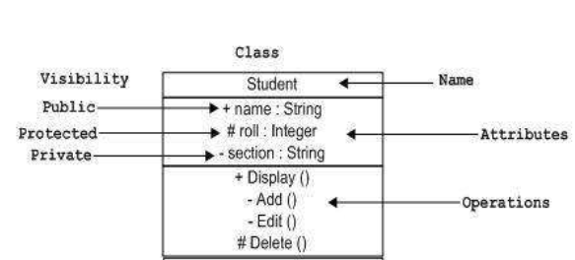
Class notation

Slide 77
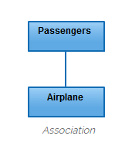
Relationship in class diagram
Association
Association is basically a set of links that connects the elements of a UML model. It also
describes how many classes are taking part in that relationship.

Slide 78
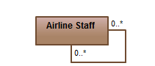
2. Reflexive Association
occurs when a class may have multiple functions or responsibilities.
For example, a staff working in an airport may be a pilot, aviation engineer, a ticket dispatcher, a guard, or a maintenance crew member.
If the maintenance crew member is managed by the aviation engineer there could be a managed by relationship in two instances of the same class.

Slide 79
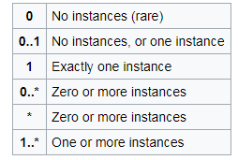
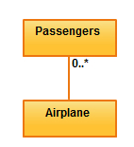
3. Multiplicity
is the active logical association when the cardinality of a class in relation to another is being depicted.
For example, one fleet may include multiple airplanes, while one commercial airplane may contain zero to many passengers. The notation 0..* in the diagram means “zero to many”.

Slide 80
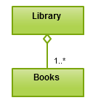
4. Aggregation
refers to the formation of a particular class as a result of one class being aggregated or built as a collection.
For example, the class “library” is made up of one or more books, among other materials.
To render aggregation in
a diagram, draw a line from
the parent class to the
child class with a diamond
shape near the parent class.

Slide 81

5. Composition
It is very similar to the aggregation relationship, with the only difference being its key purpose of emphasizing the dependence of the contained class to the life cycle of the container class.
That is, the contained class will be obliterated when the container class is destroyed.

Slide 82
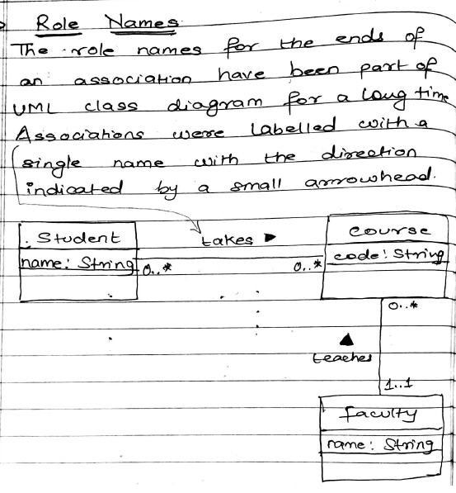
6. Role names

Slide 83
7. Generalization/ Inheritance
It refers to a type of relationship wherein one associated class is a child of another by virtue of assuming the same functionalities of the parent class.

Slide 84
Class diagram example 1
Consider an Order System of an application.
Order and Customer are identified as
The two elements of the system and they have a one to many relationship because a customer can have multiple orders.
Order class has two concrete classes (inheritance
relationship) SpecialOrder and NormalOrder.
The two inherited classes have all the properties as the Order class. In addition, they have additional functions like dispatch () and receive ().

Slide 85
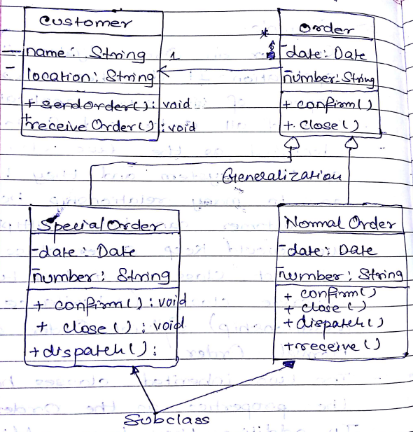

Slide 86
Usecase diagram
Usecase diagrams are a set of use cases, actors and their relationship.
A usecase represents a particular functionality of a system.
A use case diagram is used to describe the relationship among the functionalities and their internal/external controllers. These controllers are known as actors.

Slide 87

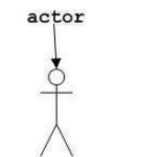
Usecase notation:- it is represented as an eclipse with a name inside it.
Actor notation:- an actor can be defined as some internal or external entity that interacts with the system.

Slide 88
Example
A customer uses bank ATM to check balances of his/her bank account, deposit funds, withdraw cash, and/or transfer funds.
ATM technician provides maintenance and repairs.
All these also involves bank whether it is related to customer transaction or to the ATM servicing.

Slide 89
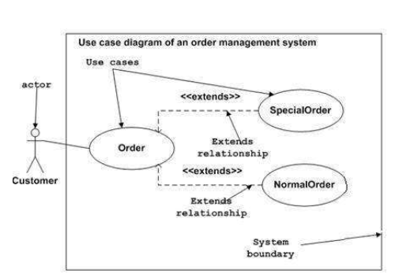
Extends relationship
it extends the base use case and adds more functionality to the system.

Slide 90
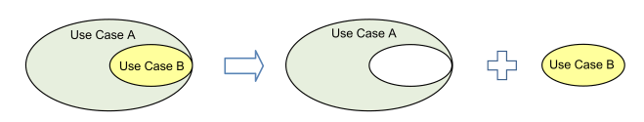
Includes relationship
Include is a directed relationship between two use cases which is used to show that behavior of the included use case (the addition) is inserted into the behavior of the including (the base) use case.
Use case B is extracted from larger use case A into a separate use case.

Slide 91
The include relationship could be used to simplify large use case by splitting it into several use cases.
Example 1
Draw usecase diagram for following events: Librarian can check availability of book, verify member, issue book, calculate fine and return book. Member can check availability of book, issue book and return book. Show “includes” relationship between usecases.

Slide 92
